Slide 1
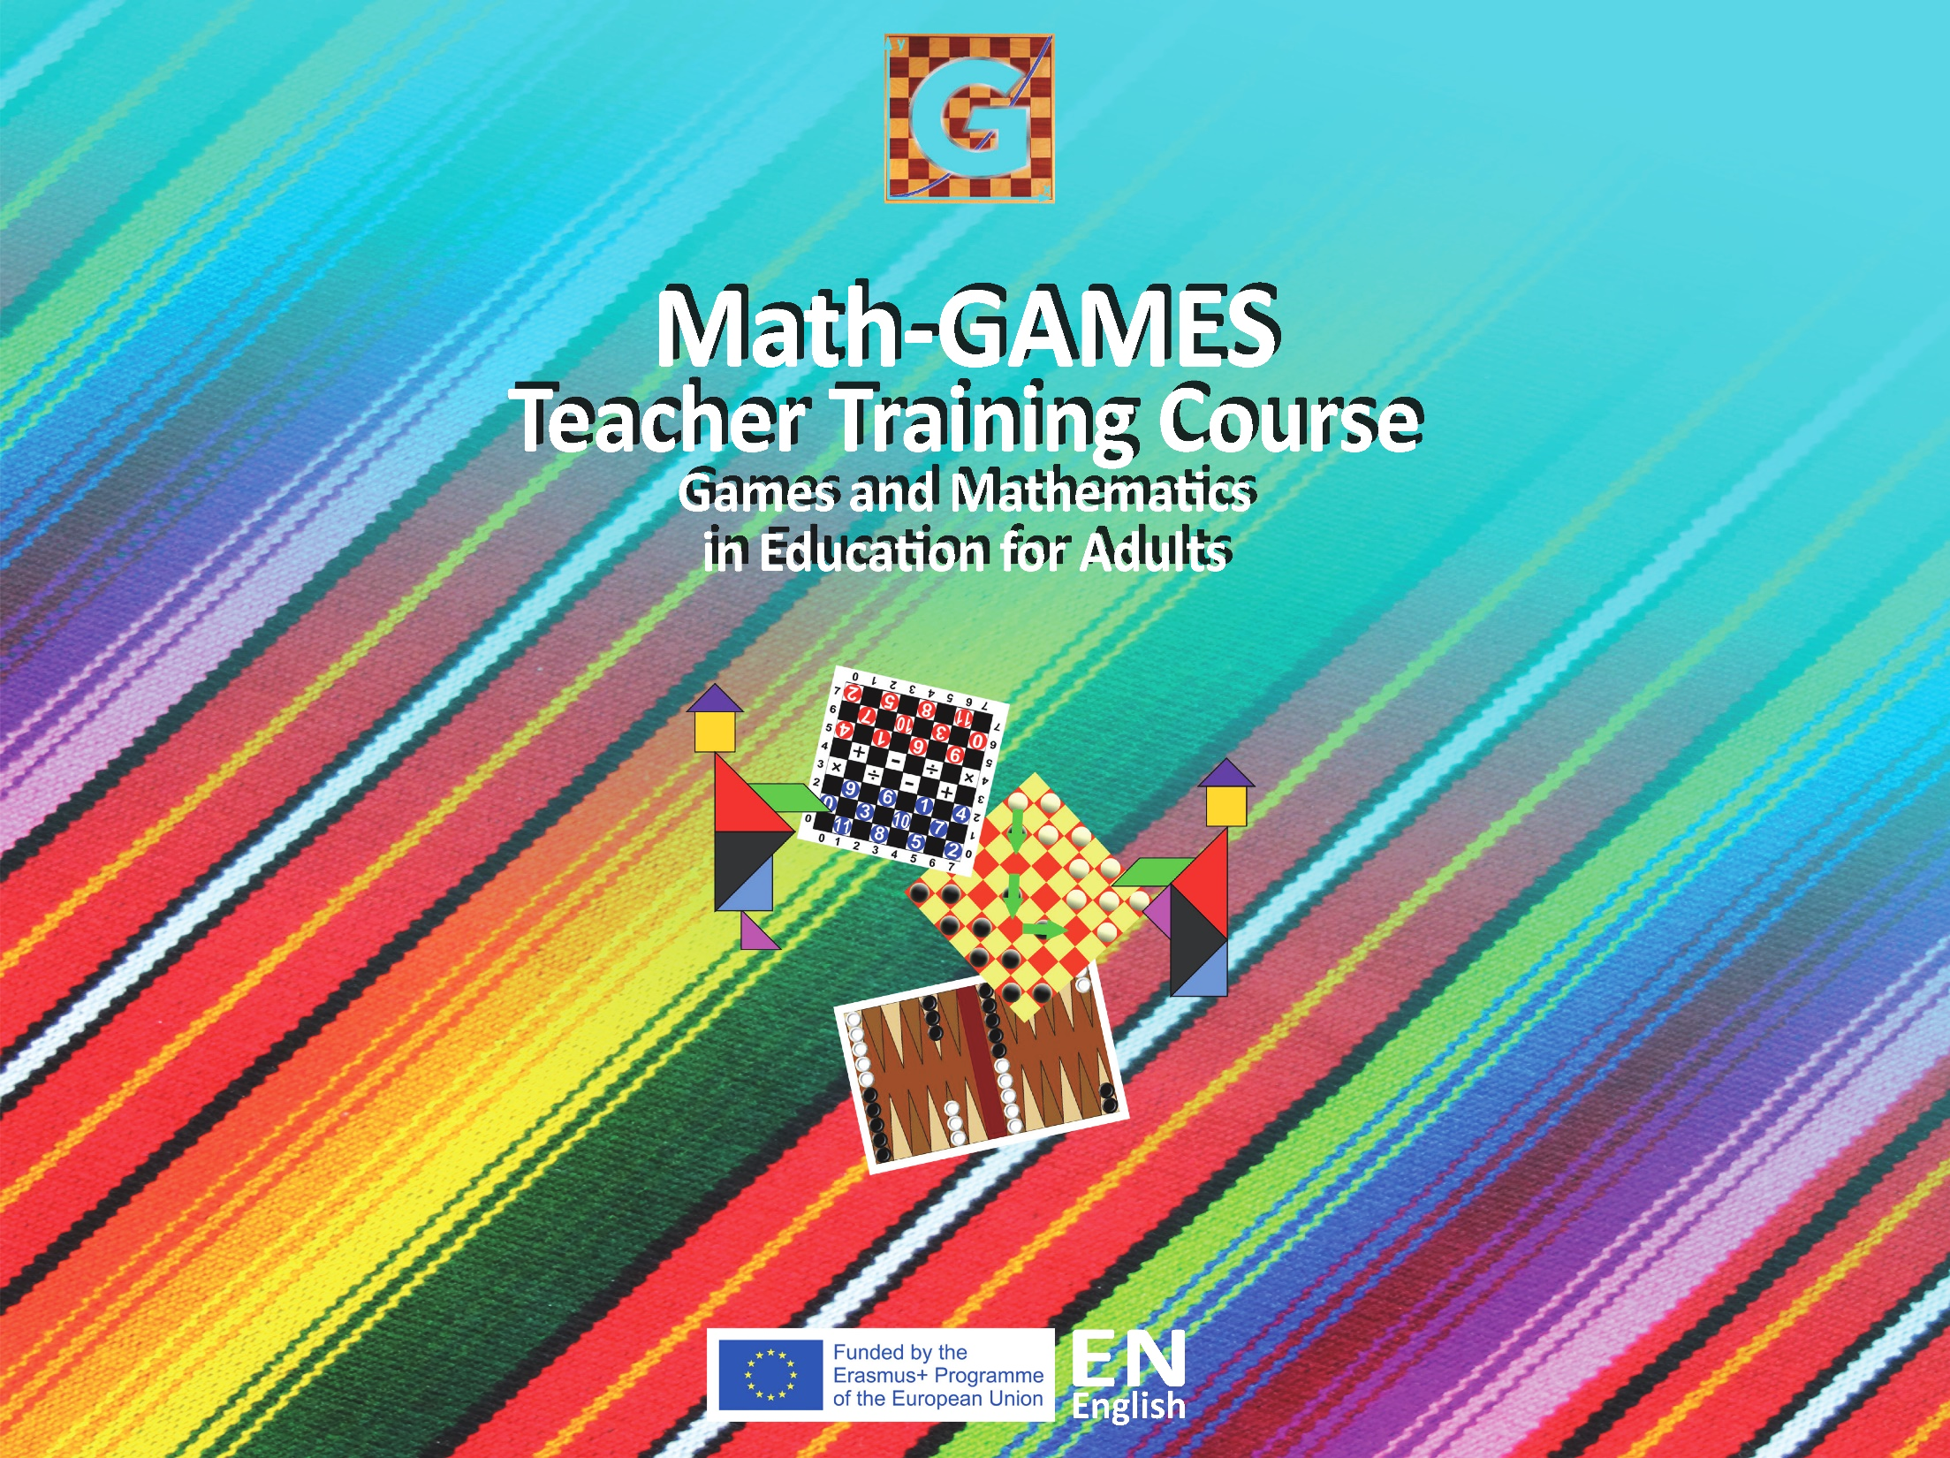

Slide 2
Objectives
Students will
learn to count and add single-digit numbers with totals to 36.
learn to multiply using single-digit whole numbers.
identify the range of possible outcomes when using one or two dices.

Slide 3
Tools, materials and organisation
Divide the students into groups of two or three. Give each pair a backgammon board.
Prepare copies of the worksheet for each student.
The lesson takes 45 to 60 minutes or more.

Slide 4
Description of the lesson
Divide the lesson into three parts
First part
Explain the game “Backgammon”.
Explain to students the coordinates, the dice and the movements.
Second part
Work on the worksheet.
Give each group a backgammon board.
Students fill the exercises in the worksheet.

Slide 5
Third part
Teacher checks the answers and discusses the results with the students.
Summarize.
Useful Hints
You can download a backgammon game with several variants from http://ai.uom.gr/nikpapa/Palamedes/
Ask students to play at least two variants of a backgammon. Then, discuss the differences and the level of difficulty between the backgammon variants.

Slide 6
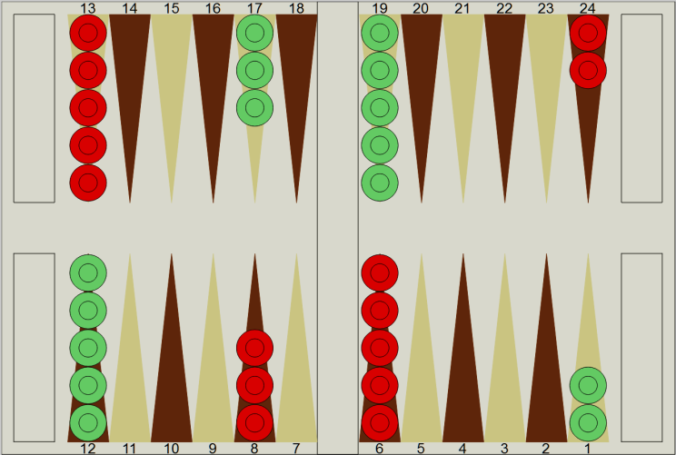
Count the checkers for each colour.
Are they the same number?
Methodology
With the help of an abacus or by using their fingers the students
count the different coloured checkers, and so learn to count and add single digit numbers.
Red : 2+5+3+5=15, Green: 5+3+5+2= 15
Red: 15, Green: 15
Yes, they are the same.

Slide 7
Exercise 1
Task A
Which roll of the two dices do you need so that checker A will hit checker B?
Task A

Slide 8
Methodology
Have the students count the number of points between the two checkers, A and B. The points between them are 7. Using an abacus or their fingers students add single digit numbers that total 7.
I roll with two dice 6 and 1, 4 and 3, 5 and 2, 1 and 6, 3 and 4, 2 and 5

Slide 9
EXERCISE 2
Write the total number of movements for each roll:
A. 5 and 6
B. 3 and 1
C. 4 and 4
D. 2 and 5
E. 6 and 6

Slide 10
Methodology
The students use their fingers or an abacus to add the single digit numbers. Focus the students’ attention to C. 4 and 4 and explain that they can add the number 4 four times (4+4+4+4=16) or they can multiply 4 times 4 (4x4=16). Explain that the same applies for E. 6 and 6. (6+6+6+6+6+6=36 or 6x6=36).

Slide 11
EXERCISE 2
Write the total number of movements for each roll:
A. 5 and 6: 5 + 6 = 11
B. 3 and 1: 3 + 1 = 4
C. 4 and 4: 4+4+4+4=16 or 4x4=16
D. 2 and 5: 2 + 5 = 7
E. 6 and 6: 6 x 6 = 36

